Slide 1
The future of universities, European cooperation and the European Universities Initiative
European university association
Anna-Lena Claeys-Kulik
Deputy Director for Policy Coordination and Foresight
@AnnaLenaKulik
#Universities2030

Slide 2
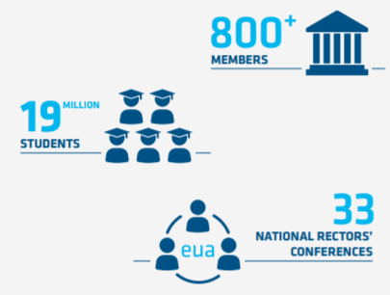
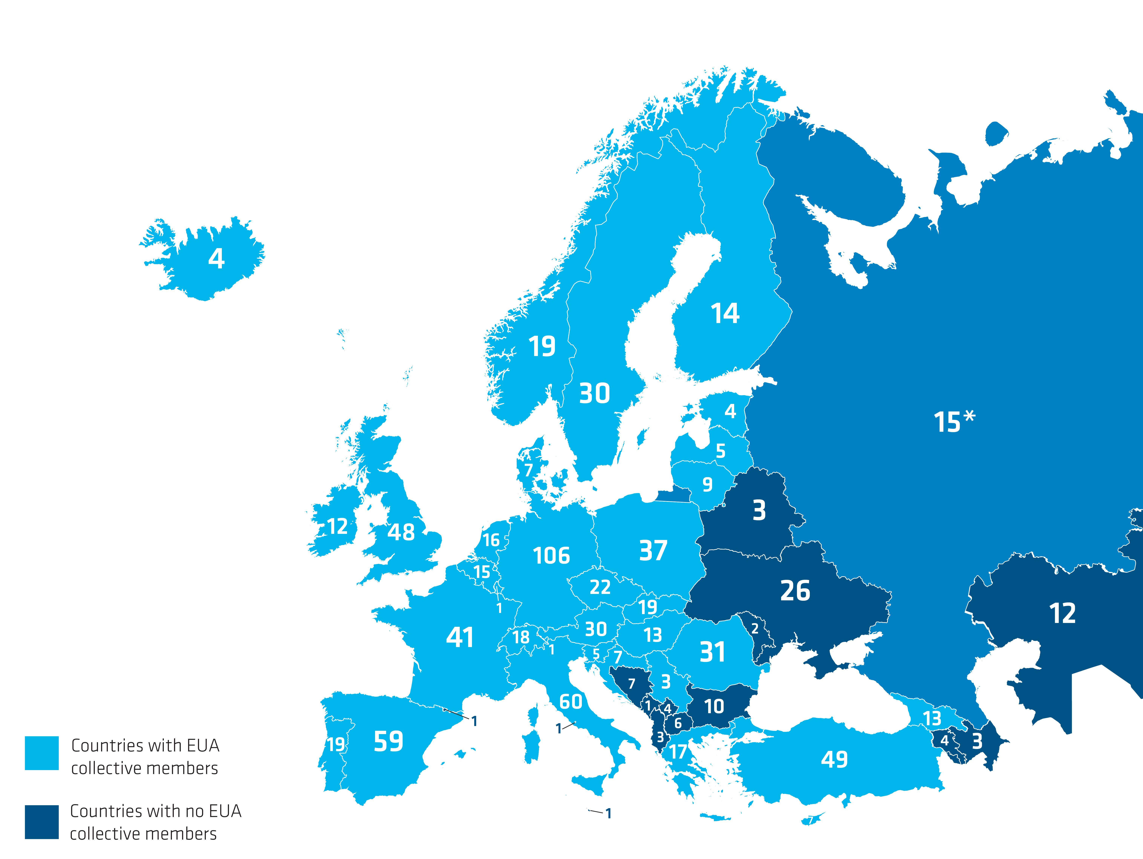
EUA has 856 members
in 49 countries (As of May 2022)

Slide 3
A vision by the sector and for the sector about what Europe’s universities should be like in 2030
The situations of universities across Europe vary.
Major challenges and trends: sustainability challenge; economic uncertainty and underfunding, democracy under pressure, social disparities, rapid technological development, demographic change, social disparities, health and geopolitical crises
Main goals of a positive normative vision for universities of the future: openess, sustainability, autonomy

Slide 4
Universities in 2030
Open, transformative and transnational
Universities as cooperative and networked institutions
Places for respite and testing new ideas
Dialogue and co-creation with society
International openess as prerequisite of quality in all missions
Universities as hybrid institutions

Slide 5
Sustainable, diverse and engaged
Sustainable development as main framework for societal engagement
Diversity and social cohesion as important parts of the sustainability agenda
Universities support pluralistic, democratic societies founded on evidence-based debate.
Universities work for an inclusive, global research and higher education community, contributing to expanding the knowledge for all.
Universities in 2030

Slide 6
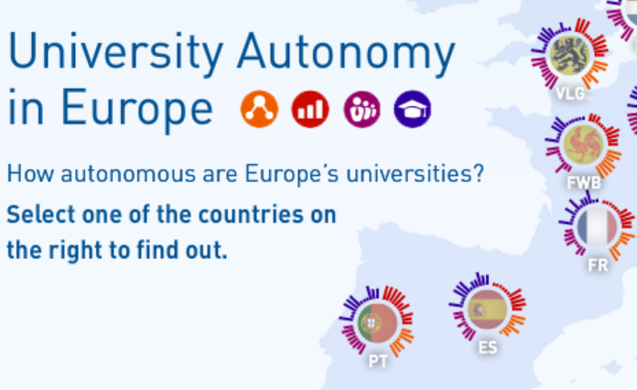
Universities in 2030
Strong, autonomous and accountable
Universities as autonomous institutions with the capacity to make strategic choices
Accountable to society at large through university governance, QA and continues dialogue
Academic freedom is upheld and actively used to participate in societal debates

Slide 7
In service of society and grounded in academic core values…
Learning & Teaching
Research
University missions in 2030
Culture
Innovation
→ uniquely combined in universities
→ equally important
→ intertwinned and mutually enhancing

Slide 8
Factors for success
Enabling frameworks
Adequate investments
Strong and inclusive leadership
(Selected) priorities for action
Reform academic careers
Promote interdisciplinarity
Strengthen civic engagement
→ Collaboration at varies levels is key to achieve the vision!
Turning the vision into practice

Slide 9
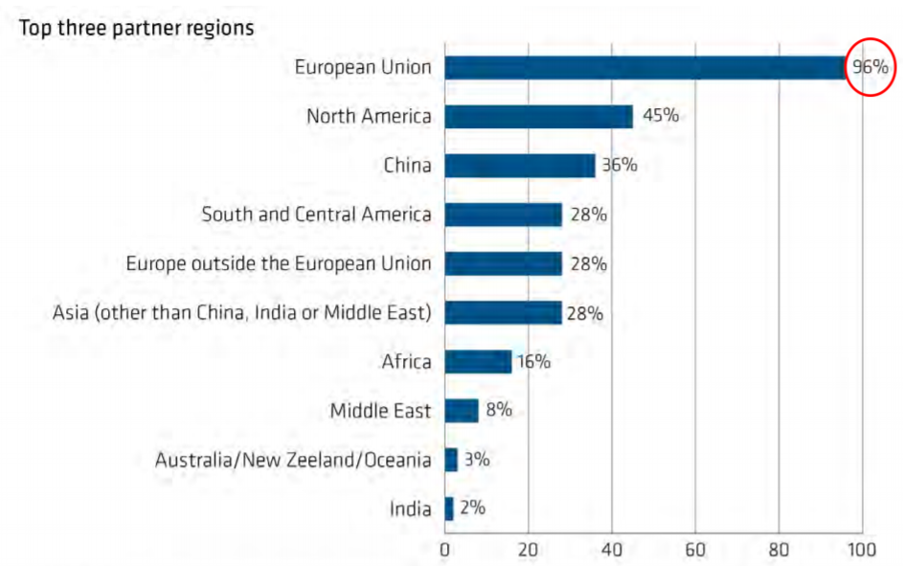
European and international cooperation is already a key feature of Europe‘s universities.
EUA survey on international strategic institutional partnerships (2020)
N=219

Slide 10
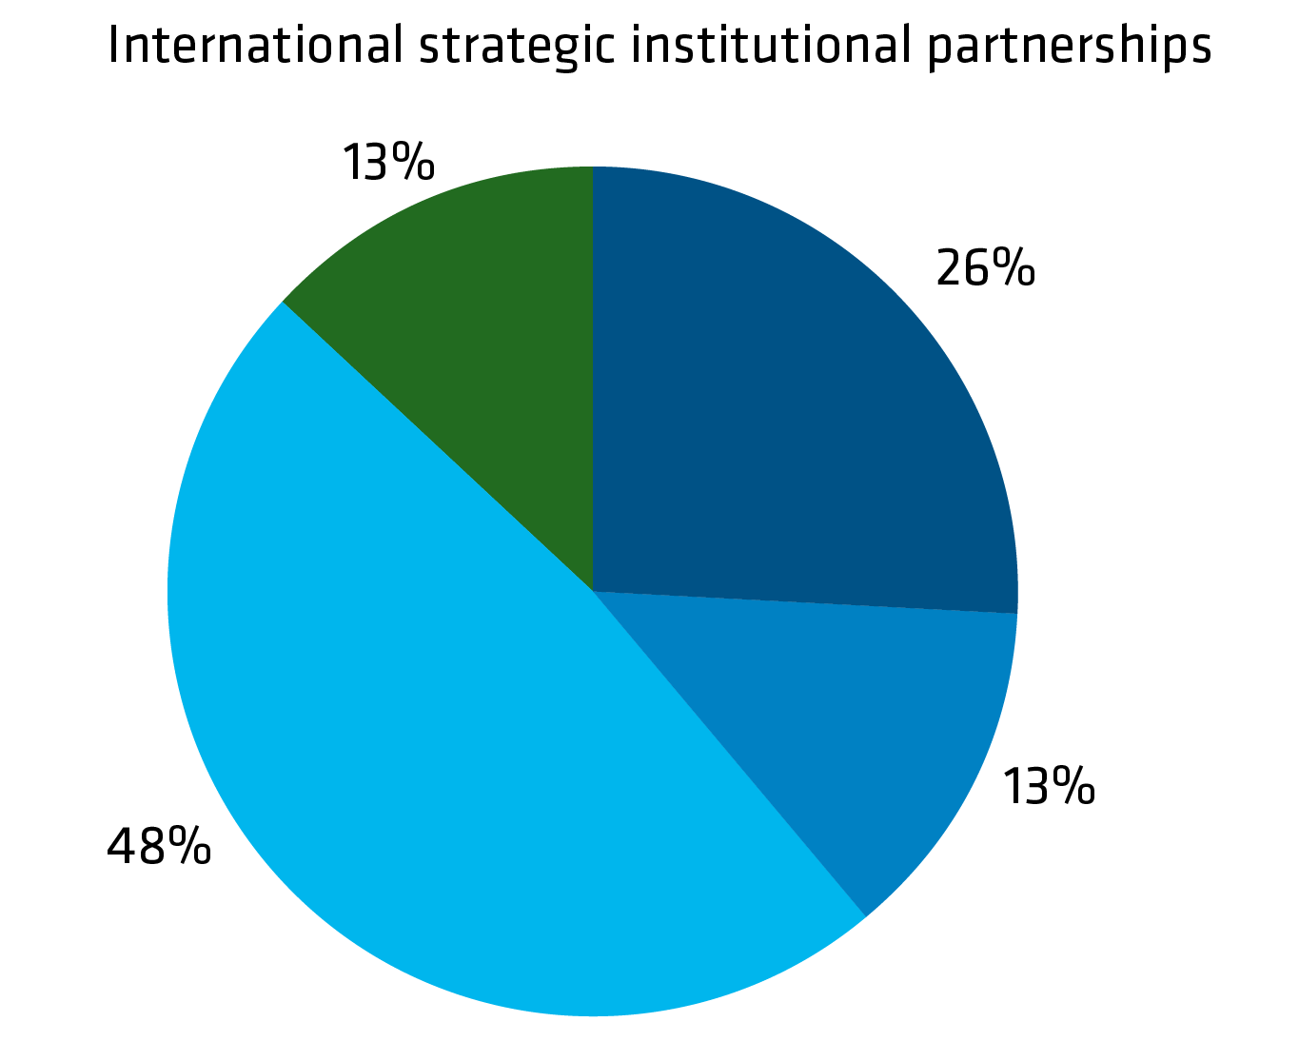
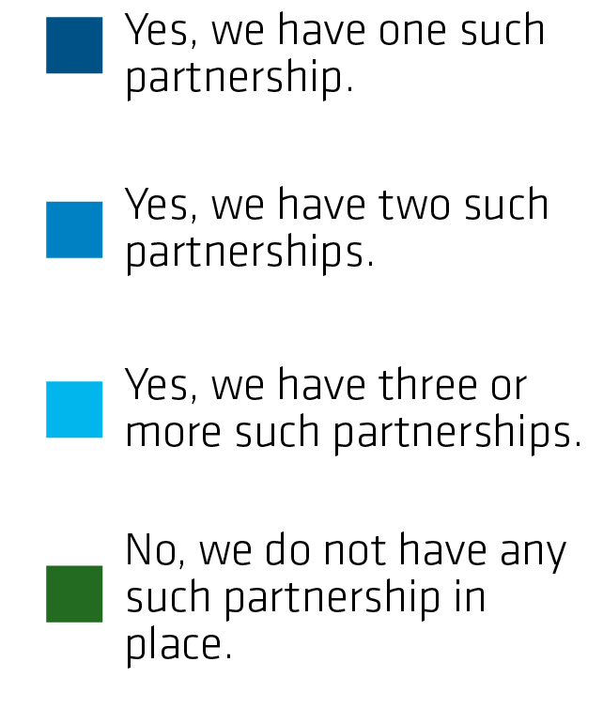
Many universities already have strategic long-term collaborations with partners abroad for several years.

Slide 11
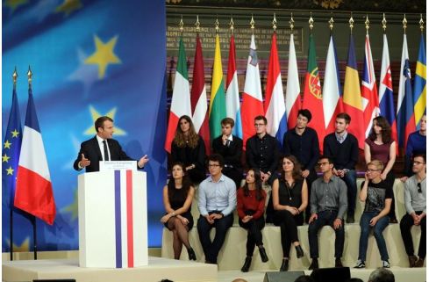
The political idea of European Universities as alliances of institutions from across Europe was born in 2017.
Ambitious political goals (as in pilot calls):
Developing some 20 alliances by 2024 in a bottom-up way by connecting existing universities
Covering all European regions and the diversity of institutional profiles
Developing a long-term joint vision and strategy (sustainability, excellence, European values)
Student-centered curricula, inter-university campuses, diverse student population
Mobility on all levels
Challenge-based learning, interdisciplinary teams, addressing societal grand challenges

Slide 12
European Council 2017 – goal: 20 alliances by 2024
1. Call 2019:
17 alliances
2. Call 2020: + 24 alliances = 41 in total
Development of the European Universities Initiative since 2017
Goal for 2024: 60 alliances with +500 universities
(~ 10% of all in Europe)
5. Call autumn
4. Call autumn 2022
3. Call 2021: 16 out of 17 from 2019 + 4 new = 44 alliances

Slide 13
Geographical distribution of universities in alliances

Slide 14
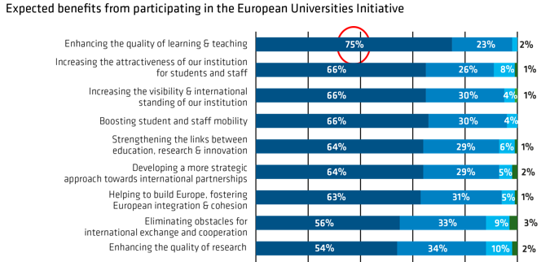
Universities expect many benefits from participating in the European Universities Initiative with enhacing the quality of learning and teaching being at the top which is in line with their general internationalisation priorities.
N=171
Notes:
Indicate the survey path: who has answered Q88, N=?

Slide 15
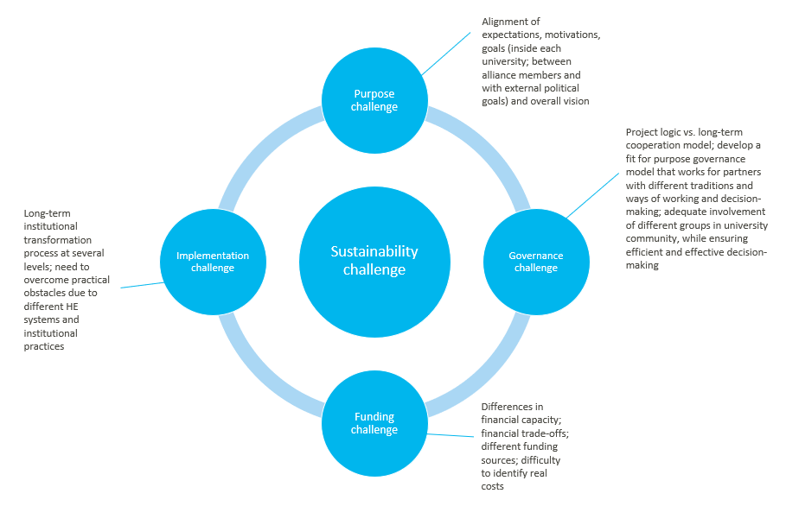
Be aware of the challenges before embarking on an alliance.

Slide 16
Current policy developments and open questions
Expansion to 60 alliances with +500 universities by 2024: how sustainable is this?
European degree label: what will it bring for alliances and their joint programmes?
European legal statute: what should be the scope? What would be the added value?
Keep the academic vision at the center of any cooperation (form follows function) and support diverse cooperation models.
Make higher education systems and regulations more flexible for transnational cooperation.
Think about the long-term effect on higher education systems.

Slide 17
Read further and download the papers on
www.eua.eu

Slide 18
Anna-Lena Claeys-Kulik
Deputy Director for Policy Coordination & Foresight European University Assocation
anna.lena.kulik@eua.eu

